Slide 1

Cryptography and Network Security
Seventh Edition
by William Stallings
Notes:
Lecture slides prepared for “Cryptography and Network Security”, 7/e, by William Stallings, Chapter 7 – “Block Cipher Operation”.

Slide 2
Chapter 6
Advanced Encryption Standard

Slide 3
AES (Advanced Encryption Standard)
Replacement needed for DES
reasons discussed before
3DES is a solution, but temporary
3DES is slow in software
3DES uses small blocks that makes even slower
Need a new standard cipher

Slide 4
AES Events in Chronological Order
NIST issued call for a standard cipher in 1997
international
15 candidates (out of 21) accepted in June 98
A shortlist of 5 selected in August 99
Rijndael (from Belgium) was selected as the AES in October 2000
issued as FIPS PUB 197 standard in November 2001

Slide 5
5 AES candidates
MARS (IBM)
RC6 (USA)
Rijndael (Belgium)
Serpent (Europe)
Twofish (USA)

Slide 6
AES Evaluation Criteria
final criteria (used to select the winner)
general security
NIST relied on evaluation done by cryptographic community
software implementation performance
execution speed, performance across different platforms (8 to 64 bit platforms)
hardware implementation
not only timings, but also cost is important
especially for restricted space environments (such as smartcards)
implementation (timing and power) attacks

Slide 7
AES
symmetric block cipher
128-bit data (block size)
128/192/256-bit keys
stronger & faster than Triple-DES
provide full specification and design details

Slide 8
State of art
AES GCM | Used in TLS 1.2
AES CCM
AES CBC
FTPS, HTTPS, SFTP, etc.

Slide 9
Advanced Encryption Standard
The cipher takes a plaintext block size of 128 bits, or 16 bytes.
The key length can be 16, 24, or 32 bytes (128, 192, or 256 bits).
The algorithm is referred to as AES-128, AES-192, or AES-256, depending on the key length.
Plaintext
Secret Key
Add Round Key
Substitution
Subbytes
Shift Rows
Permutation
Mix Columns
Not for last Round
Add Round Key
Round
Obfuscation/scrambling
…

Slide 10
AES is a Subs-Perm network (not Feistel)
k₀
k₁
k_{n}
S₁
S₁
S₁
S₂
S₂
S₂
S₃
S₃
S₃
⋯
⨁
input
⨁
output
⨁
⋯
⋯
⋯
S₈
S₈
S₈
subs.
layer
perm.
layer
inversion

Slide 11
AES-128 schematic
10 rounds
4
ByteSub
ShiftRow
MixColumn
ByteSub
ShiftRow
MixColumn
ByteSub
ShiftRow
input
⋯
4
⨁
⨁
⨁
⨁
k₀
invertible
k₁
k₂
k₉
⨁
k₁₀
key
output
4
key expansion:
16 bytes
16 bytes ⟶176 bytes
4

Slide 12
Advanced Encryption Standard
32
43
f6
a8
88
5a
30
8d
31
31
98
2a
e0
37
Key
07
39
Plaintext
32
88
31
e0
Key
43
5a
31
37
2b
28
a9
s4
Column major order
f6
30
98
07
23
30
a3
34
a8
8d
2a
39
98
5a
21
19
STATE
4*4 Grid
02
c1
4f
34
2a
HEX Notation:
0010 1010
8 bits

Slide 13
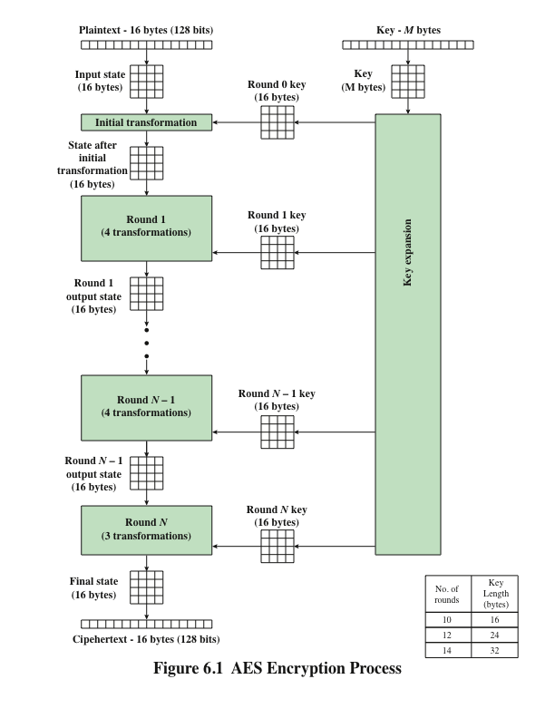
Notes:
Figure 6.1 shows the overall structure of the AES encryption process. The cipher
takes a plaintext block size of 128 bits, or 16 bytes. The key length can be 16, 24, or
32 bytes (128, 192, or 256 bits). The algorithm is referred to as AES-128, AES-192, or
AES-256, depending on the key length.

Slide 14
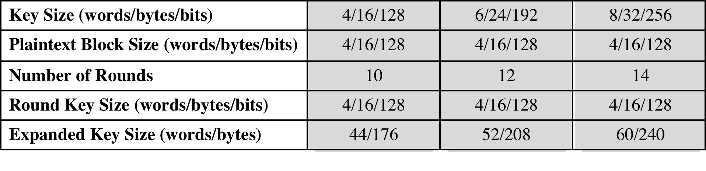
Table 6.1 AES Parameters
Notes:
The cipher consists of N rounds, where the number of rounds depends on the
key length: 10 rounds for a 16-byte key, 12 rounds for a 24-byte key, and 14 rounds
for a 32-byte key (Table 6.1). The first N - 1 rounds consist of four distinct transformation
functions: SubBytes, ShiftRows, MixColumns, and AddRoundKey, which are
described subsequently. The final round contains only three transformations, and
there is a initial single transformation (AddRoundKey) before the first round, which
can be considered Round 0. Each transformation takes one or more 4 * 4 matrices
as input and produces a 4 * 4 matrix as output. Figure 6.1 shows that the output of
each round is a 4 * 4 matrix, with the output of the final round being the ciphertext.
Also, the key expansion function generates N + 1 round keys, each of which is a distinct
4 * 4 matrix. Each round key serves as one of the inputs to the AddRoundKey
transformation in each round.

Slide 15
Sub bytes
00 | 01 | 02 | 03 | 04 | 05 | 06 | 07 | 08 | 09 | 0a | 0b | 0c | 0d | 0e | 0f
00 | 63 | 7c | 77 | 7b | f2 | 6b | 6f | c5 | 30 | 01 | 67 | 2b | fe | d7 | ab | 76
10 | ca | 82 | c9 | 7d | fa | 59 | 47 | f0 | ad | d4 | a2 | af | 9c | a4 | 72 | c0
20 | b7 | fd | 93 | 26 | 36 | 3f | f7 | cc | 34 | a5 | e5 | f1 | 71 | d8 | 31 | 15
30 | 04 | c7 | 23 | c3 | 18 | 96 | 05 | 9a | 07 | 12 | 80 | e2 | eb | 27 | b2 | 75
40 | 09 | 83 | 2c | 1a | 1b | 6e | 5a | a0 | 52 | 3b | d6 | b3 | 29 | e3 | 2f | 84
50 | 53 | d1 | 00 | ed | 20 | fc | b1 | 5b | 6a | cb | be | 39 | 4a | 4c | 58 | cf
60 | d0 | ef | aa | fb | 43 | 4d | 33 | 85 | 45 | f9 | 02 | 7f | 50 | 3c | 9f | a8
70 | 51 | a3 | 40 | 8f | 92 | 9d | 38 | f5 | bc | b6 | da | 21 | 10 | ff | f3 | d2
80 | cd | 0c | 13 | ec | 5f | 97 | 44 | 17 | c4 | a7 | 7e | 3d | 64 | 5d | 19 | 73
90 | 60 | 81 | 4f | dc | 22 | 2a | 90 | 88 | 46 | ee | b8 | 14 | de | 5e | 0b | db
a0 | e0 | 32 | 3a | 0a | 49 | 06 | 24 | 5c | c2 | d3 | ac | 62 | 91 | 95 | e4 | 79
b0 | e7 | c8 | 37 | 6d | 8d | d5 | 4e | a9 | 6c | 56 | f4 | ea | 65 | 7a | ae | 08
c0 | ba | 78 | 25 | 2e | 1c | a6 | b4 | c6 | e8 | dd | 74 | 1f | 4b | bd | 8b | 8a
d0 | 70 | 3e | b5 | 66 | 48 | 03 | f6 | 0e | 61 | 35 | 57 | b9 | 86 | c1 | 1d | 9e
e0 | e1 | f8 | 98 | 11 | 69 | d9 | 8e | 94 | 9b | 1e | 87 | e9 | ce | 55 | 28 | df
f0 | 8c | a1 | 89 | 0d | bf | e6 | 42 | 68 | 41 | 99 | 2d | 0f | b0 | 54 | bb | 16
Sub bytes
32
88
31
e0
43
5a
31
37
f6
30
98
07
a8
8d
2a
39
S-BOX

Slide 16
Substitution
Happens on a lookup table,
Each byte is mapped to a different byte, based on a function.
Non-linear,
Difficult to represent.
Nosubstitution with itself,
No reverse order.
No flip.

Slide 17
Shift Rows
Shift Rows
32
88
31
e0
32
88
31
e0
No change
43
5a
31
37
5a
31
37
43
Shift Row by 1
f6
30
98
07
98
07
f6
30
Shift Row by 2
a8
8d
2a
39
39
a8
8d
2a
Shift Row by 3

Slide 18
Shift Row Rationale
More substantial than it may first appear
The State, as well as the cipher input and output, is treated as an array of four 4-byte columns
On encryption, the first 4 bytes of the plaintext are copied to the first column of State, and so on
The round key is applied to State column by column
Thus, a row shift moves an individual byte from one column to another, which is a linear distance of a multiple of 4 bytes
Transformation ensures that the 4 bytes of one column are spread out to four different columns
Notes:
The shift row transformation is more substantial than it may first
appear. This is because the State , as well as the cipher input and output, is
treated as an array of four 4-byte columns. Thus, on encryption, the first 4 bytes
of the plaintext are copied to the first column of State , and so on. Furthermore,
as will be seen, the round key is applied to State column by column. Thus, a row
shift moves an individual byte from one column to another, which is a linear
distance of a multiple of 4 bytes. Also note that the transformation ensures that
the 4 bytes of one column are spread out to four different columns. Figure 6.4
illustrates the effect.

Slide 19
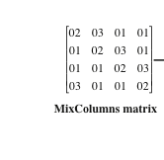
Mix Columns
d4
Mix Columns
bf
32
04
31
e0
5d
43
66
31
37
32
d4
31
e0
30
f6
81
98
07
43
bf
31
37
a8
e5
2a
39
f6
5d
98
07
Matrix Multiplication with a given matrix.
Finite field arithmetic.
The individual additions and multiplications are performed in GF(2⁸).
- Adding is XOR, multiplication is in the Finite field.
a8
30
2a
39
Notes:
Matrix is given and fixed. It is good enough to scramble elements and it is fast.
Columnwise: starts with 2,1,1,3 and then shifts one position at each column.

Slide 20
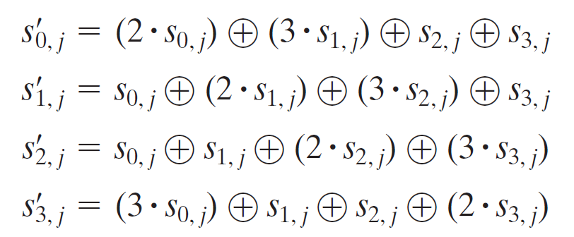
The MixColumns transformation on a single column of State can be expressed as
bitwise XOR operation

Slide 21
Galois Arithmetic
MixColumns requires matrix multiplication in the field GF(2⁸), which means that all operations are carried out on bytes
HEX 02 is represented in binary as: 0000 0010
In Gf(2⁸) it is a polinomial: x⁷+ x⁶+ x⁵+ x⁴+ x³+ x²+ x+ 1
0000 0010 = x
Same wise: d4=11010100=x⁷+ x⁶+ x⁴+ x²

Slide 22
Galois Arithmetic
In addition, two similar terms cancel eachother.
Irreducable polinomial:
x⁸ = x⁴+ x³+ x+ 1

Slide 23
Mix Columns Rationale
Coefficients of a matrix based on a linear code with maximal distance between code words ensures a good mixing among the bytes of each column
The mix column transformation combined with the shift row transformation ensures that after a few rounds all output bits depend on all input bits
Notes:
The coefficients of the matrix in Equation (6.3) are based on a linear
code with maximal distance between code words, which ensures a good mixing
among the bytes of each column. The mix column transformation combined with
the shift row transformation ensures that after a few rounds all output bits depend
on all input bits. See [DAEM99] for a discussion.
In addition, the choice of coefficients in MixColumns, which are all {01}, { 02},
or { 03}, was influenced by implementation considerations. As was discussed, multiplication
by these coefficients involves at most a shift and an XOR. The coefficients
in InvMixColumns are more formidable to implement. However, encryption was
deemed more important than decryption for two reasons:
1. For the CFB and OFB cipher modes (Figures 7.5 and 7.6; described in Chapter 7),
only encryption is used.
2. As with any block cipher, AES can be used to construct a message authentication
code (Chapter 13), and for this, only encryption is used.

Slide 24
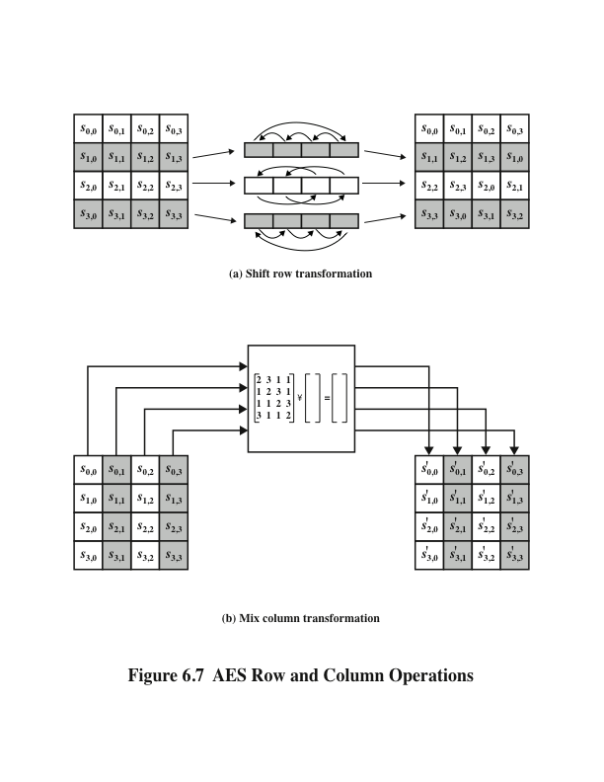
Notes:
The forward shift row transformation ,
called ShiftRows, is depicted in Figure 6.7a. The first row of State is not altered. For
the second row, a 1-byte circular left shift is performed. For the third row, a 2-byte
circular left shift is performed. For the fourth row, a 3-byte circular left shift is performed.
The following is an example of ShiftRows.
The inverse shift row transformation , called InvShiftRows, performs the circular
shifts in the opposite direction for each of the last three rows, with a 1-byte
circular right shift for the second row, and so on.
The forward mix column transformation,
called MixColumns, operates on each column individually. Each byte of a column
is mapped into a new value that is a function of all four bytes in that column. The
transformation can be defined by the following matrix multiplication on State
(Figure 6.7b)
Each element in the product matrix is the sum of products of elements of one row
and one column. In this case, the individual additions and multiplications are
performed in GF(2⁸ ).

Slide 25
AddRoundKey Transformation
The 128 bits of State are bitwise XORed with the 128 bits of the round key
Operation is viewed as a columnwise operation between the 4 bytes of a State column and one word of the round key
Can also be viewed as a byte-level operation
Rationale:
Is as simple as possible and affects every bit of State
The complexity of the round key expansion plus the complexity of the other stages of AES ensure security
Notes:
In the forward add round key transformation ,
called AddRoundKey, the 128 bits of State are bitwise XORed with the 128
bits of the round key. As shown in Figure 6.5b, the operation is viewed as a columnwise
operation between the 4 bytes of a State column and one word of the round
key; it can also be viewed as a byte-level operation.
The add round key transformation is as simple as possible and affects
every bit of State . The complexity of the round key expansion, plus the complexity
of the other stages of AES, ensure security.

Slide 26
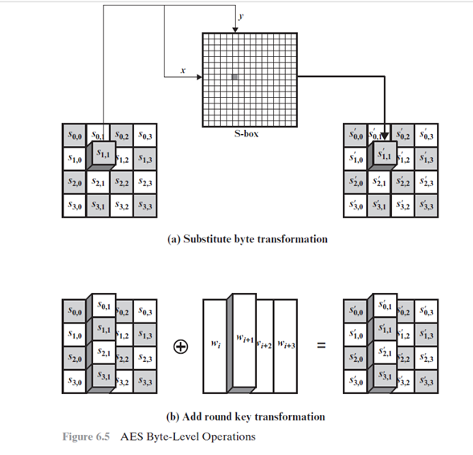
AddRoundKey Transformation

Slide 27
Notes:
Figure 6.8 is another view of a single round of AES, emphasizing the mechanisms
and inputs of each transformation.

Slide 28
AES Key Expansion
Takes as input a four-word (16 byte) key and produces a linear array of 44 words (176) bytes
This is sufficient to provide a four-word round key for the initial AddRoundKey stage and each of the 10 rounds of the cipher
Key is copied into the first four words of the expanded key
The remainder of the expanded key is filled in four words at a time
Each added word w[i] depends on the immediately preceding word, w[i – 1], and the word four positions back, w[i – 4]
In three out of four cases a simple XOR is used
For a word whose position in the w array is a multiple of 4, a more complex function is used
Notes:
The AES key expansion algorithm takes as input a four-word (16-byte) key and
produces a linear array of 44 words (176 bytes). This is sufficient to provide a four word
round key for the initial AddRoundKey stage and each of the 10 rounds of the
cipher. The pseudocode on the next page describes the expansion.
The key is copied into the first four words of the expanded key. The remainder
of the expanded key is filled in four words at a time. Each added word w [i]
depends on the immediately preceding word, w [i - 1], and the word four positions
back, w [i - 4]. In three out of four cases, a simple XOR is used. For a word whose
position in the w array is a multiple of 4, a more complex function is used.

Slide 29
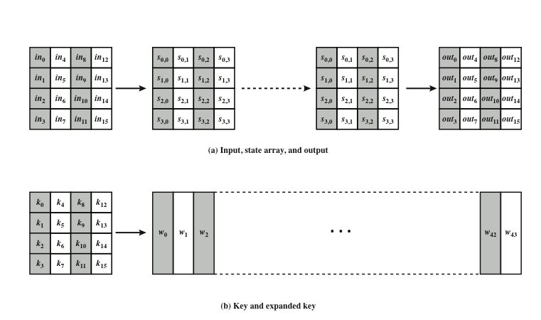
Key is expanded at the beginning and round keys are used in each round.
Notes:
The input to the encryption and decryption algorithms is a single 128-bit block.
In FIPS PUB 197, this block is depicted as a 4 * 4 square matrix of bytes. This
block is copied into the State array, which is modified at each stage of encryption or
decryption. After the final stage, State is copied to an output matrix. These operations
are depicted in Figure 6.2a. Similarly, the key is depicted as a square matrix of bytes.
This key is then expanded into an array of key schedule words. Figure 6.2b shows the
expansion for the 128-bit key. Each word is four bytes, and the total key schedule
is 44 words for the 128-bit key. Note that the ordering of bytes within a matrix is by
column. So, for example, the first four bytes of a 128-bit plaintext input to the encryption
cipher occupy the first column of the in matrix, the second four bytes occupy the
second column, and so on. Similarly, the first four bytes of the expanded key, which
form a word, occupy the first column of the w matrix.

Slide 30
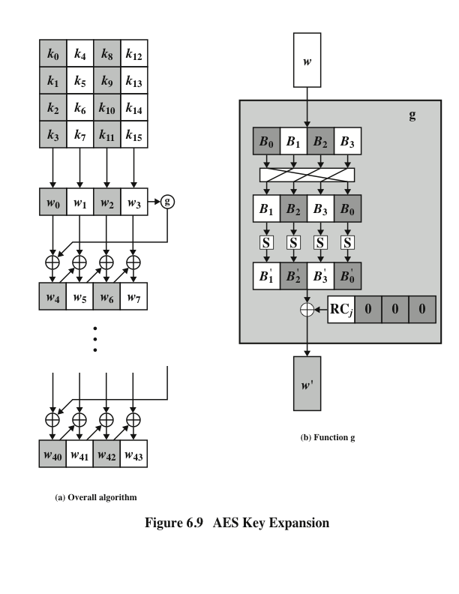
Notes:
Figure 6.9 illustrates the generation of the expanded key, using the symbol g to represent that
complex function.

Slide 31
Key Expansion Rationale
The specific criteria that were used are:
Knowledge of a part of the cipher key or round key does not enable calculation of many other round-key bits
An invertible transformation
Speed on a wide range of processors
Usage of round constants to eliminate symmetries
Diffusion of cipher key differences into the round keys
Enough nonlinearity to prohibit the full determination of round key differences from cipher key differences only
Simplicity of description
The Rijndael developers designed the expansion key algorithm to be resistant to known cryptanalytic attacks
Inclusion of a round-dependent round constant eliminates the symmetry between the ways in which round keys are generated in different rounds
Notes:
The Rijndael developers designed the expansion key algorithm to be resistant to
known cryptanalytic attacks. The inclusion of a round-dependent round constant
eliminates the symmetry, or similarity, between the ways in which round keys are
generated in different rounds. The specific criteria that were used are [DAEM99]
• Knowledge of a part of the cipher key or round key does not enable calculation
of many other round-key bits.
• An invertible transformation [i.e., knowledge of any Nk consecutive words of
the expanded key enables regeneration of the entire expanded key (Nk = key
size in words)].
• Speed on a wide range of processors.
• Usage of round constants to eliminate symmetries.
• Diffusion of cipher key differences into the round keys; that is, each key bit
affects many round key bits.
• Enough nonlinearity to prohibit the full determination of round key differences
from cipher key differences only.
• Simplicity of description.
The authors do not quantify the first point on the preceding list, but the idea
is that if you know less than Nk consecutive words of either the cipher key or one of
the round keys, then it is difficult to reconstruct the remaining unknown bits. The
fewer bits one knows, the more difficult it is to do the reconstruction or to determine
other bits in the key expansion.

Slide 32
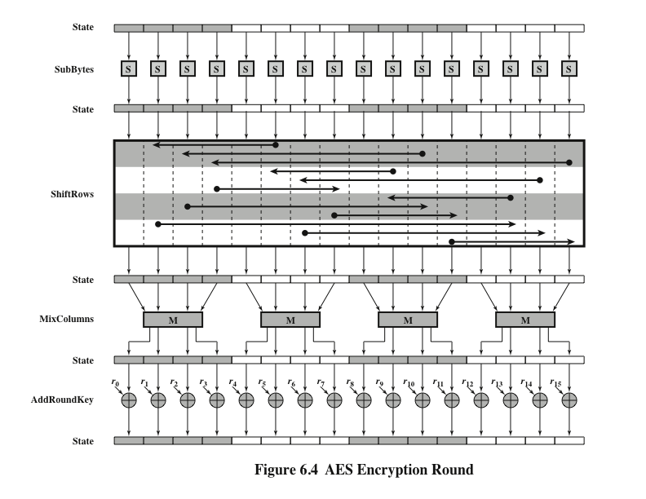
Notes:
Figure 6.4 depicts the structure of a full encryption round.

Slide 33
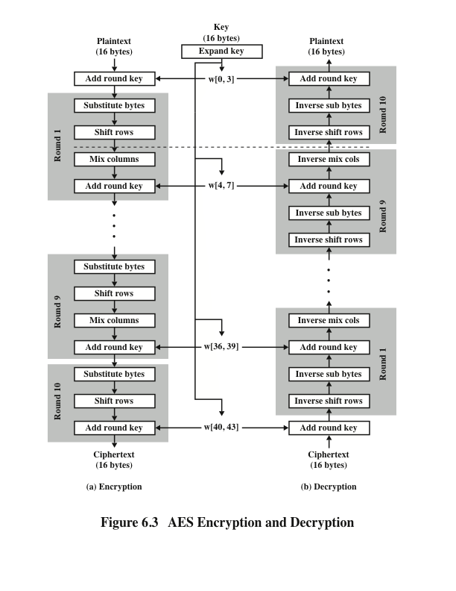
Notes:
Figure 6.3 shows the AES cipher in more detail, indicating the sequence of transformations
in each round and showing the corresponding decryption function. As was
done in Chapter 4, we show encryption proceeding down the page and decryption
proceeding up the page.

Slide 34
Overview
Processes the entire data block as a single matrix during each round using substitutions and permutation
The key that is provided as input is expanded into an array of forty-four 32-bit words, w[i]
The cipher begins and ends with an AddRoundKey stage
Can view the cipher as alternating operations of XOR encryption (AddRoundKey) of a block, followed by scrambling of the block (the other three stages), followed by XOR encryption, and so on
Each stage is easily reversible
The decryption algorithm makes use of the expanded key in reverse order, however the decryption algorithm is NOT identical to the encryption algorithm
State is the same for both encryption and decryption
Final round of both encryption and decryption consists of only three stages
Four different stages are used:
Substitute bytes – uses an S-box to perform a byte-by-byte substitution of the block
ShiftRows – a simple permutation
MixColumns – a substitution that makes use of arithmetic over GF(2⁸)
AddRoundKey – a simple bitwise XOR of the current block with a portion of the expanded key
Notes:
Before delving into details, we can make several comments about the overall
AES structure.
1. One noteworthy feature of this structure is that it is not a Feistel structure.
Recall that, in the classic Feistel structure, half of the data block is used to
modify the other half of the data block and then the halves are swapped. AES
instead processes the entire data block as a single matrix during each round
using substitutions and permutation.
2. The key that is provided as input is expanded into an array of forty-four 32-bit
words, w [i ]. Four distinct words (128 bits) serve as a round key for each round;
these are indicated in Figure 6.3.
3. Four different stages are used, one of permutation and three of substitution:
• Substitute bytes: Uses an S-box to perform a byte-by-byte substitution of
the block
• ShiftRows: A simple permutation
• MixColumns: A substitution that makes use of arithmetic over GF(2⁸ )
• AddRoundKey: A simple bitwise XOR of the current block with a portion
of the expanded key
4. The structure is quite simple. For both encryption and decryption, the
cipher begins with an AddRoundKey stage, followed by nine rounds that each
includes all four stages, followed by a tenth round of three stages.
5. Only the AddRoundKey stage makes use of the key. For this reason, the cipher
begins and ends with an AddRoundKey stage. Any other stage, applied at the
beginning or end, is reversible without knowledge of the key and so would add
no security.
6. The AddRoundKey stage is, in effect, a form of Vernam cipher and by itself
would not be formidable. The other three stages together provide confusion,
diffusion, and nonlinearity, but by themselves would provide no security
because they do not use the key. We can view the cipher as alternating operations
of XOR encryption (AddRoundKey) of a block, followed by scrambling
of the block (the other three stages), followed by XOR encryption, and so on.
This scheme is both efficient and highly secure.
7. Each stage is easily reversible. For the Substitute Byte, ShiftRows, and
MixColumns stages, an inverse function is used in the decryption algorithm.
For the AddRoundKey stage, the inverse is achieved by XORing the same
round key to the block.
8. As with most block ciphers, the decryption algorithm makes use of the
expanded key in reverse order. However, the decryption algorithm is not
identical to the encryption algorithm. This is a consequence of the particular
structure of AES.
9. Once it is established that all four stages are reversible, it is easy to verify
that decryption does recover the plaintext. Figure 6.3 lays out encryption
and decryption going in opposite vertical directions. At each horizontal point
(e.g., the dashed line in the figure), State is the same for both encryption and
decryption.
10. The final round of both encryption and decryption consists of only three stages.
Again, this is a consequence of the particular structure of AES and is required
to make the cipher reversible.

